Slide 1


Information Technology Auditing
Introduction
The Audit Function
The IT Auditor’s Toolkit
Auditing the Computerized IS
Information Technology Auditing Today

Slide 2

The Audit Function
The function of an audit
is to examine and to assure.
will differ according to the subject under examination.
can be internal, or external, and
Information technology auditing discusses
internal auditing,
External auditing, and
IT auditing.
Notes:
4

Slide 3


Internal Auditing
An internal audit, which preserves its objectivity
is carried out by company personnel reporting to
  top management and/or
  the Audit Committee of the Board of Directors
is external to the corporate department or
division being audited
concerns employee adherence to
  company policies and procedures, evaluation
  of internal controls
Notes:
7

Slide 4
Internal Auditing
is relatively broad in scope, including
  auditing for fraud,
  ensuring that employees are not
  copying software programs illegally
can provide assurance to a company’s
top management about
  the efficiency of its organization and
  effectiveness of its organization
Notes:
7

Slide 5
External Auditing
The external audit
is carried out by independent system auditors
has the attest function as its chief purpose confirming
  the accuracy of transacted data and
  fairness of the operations of a system.
includes a variety of assurance services now
Notes:
7

Slide 6

Information Technology Auditing
Information technology (IT) auditing
involves evaluating the computer’s role in achieving
  audit objectives and
  control objectives
means proving data and information are
  reliable,
  confidential,
  secure, and
  available as needed
includes attest objectives like
  safeguarding of assets and data integrity,
  operational effectiveness.

Slide 7
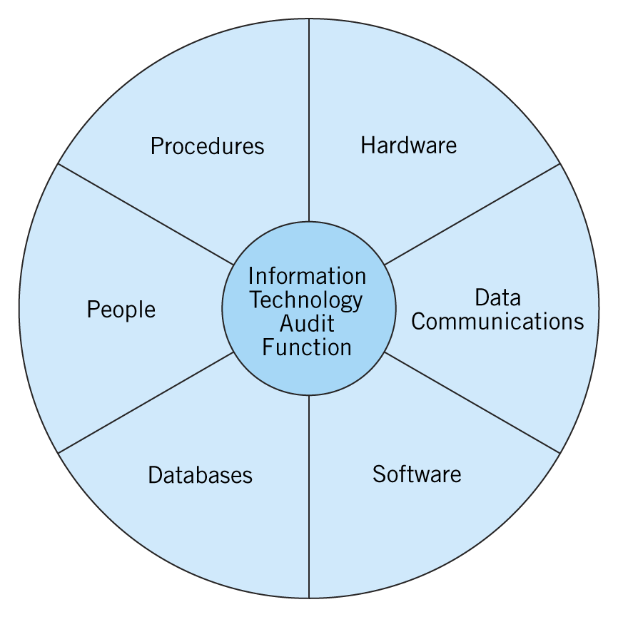
The IT Audit
The IT audit function encompasses

Slide 8
Effectiveness of Information Systems Controls
An external auditor’s objectives are
to evaluate the risks
  to the integrity of sytem’s data
to make recommendations
  to managers
  to improve these controls.

Slide 9

Risk Assessment
A risk-based audit approach involves
Determining the threats facing the IS
  errors and irregularities
Identifying the control procedures
  to prevent or detect the errors
  and irregularities
Notes:
9

Slide 10

Risk Assessment
Evaluating the control procedures within the IS
  observing system operations,
  inspecting documents, records, and reports,
  checking samples of system inputs and outputs, and
  tracing transactions through the system
Evaluating weaknesses
  identifying control deficiencies
  determining compensating controls
  to make up for the deficiency
Notes:
9

Slide 11
Information Systems Risk Assessment
Information Systems Risk Assessment evaluates
  desirability of IT controls for an aspect of business risk.
  disaster recovery or business continuity plan
Auditors and managers must answer each of the
following questions:
  What assets or information does the company have that
  unauthorized individuals would want?
  What is the value of these identified assets of information?
  How can unauthorized individuals obtain valuable assets or information?
  What are the chances of unauthorized individuals obtaining
  valuable assets or information?

Slide 12
Guidance in Reviewing and Evaluating IT Controls
Two guides available to IT auditors
Systems Auditability and Control (SAC) report
  identifies important information technologies and
  specific risks related to these technologies
  recommends controls to mitigate risks and
  suggests audit procedures to validate these controls

Slide 13
Guidance in Reviewing and Evaluating IT Controls
Control Objectives for Information and Related Technology (COBIT) provides guidance in
  assessing business risks,
  controlling for business risks, and
  evaluating the effectiveness of controls

Slide 14
Guidance in Reviewing and Evaluating IT Controls
COBIT is an internal control framework and model that encompasses an organization’s IT governance and information technologies.

Slide 15
The Information Technology Auditor’s Toolkit
IT auditors need to have
the technical skills to understand the vulnerabilities in
  hardware and software
  use of appropriate software to do their jobs
  general-use software such as
    word processing programs,
    spreadsheet software, and
    database management systems.
  generalized audit software (GAS), and

Slide 16
The Information Technology Auditor’s Toolkit
people skills
  to work as a team
  to interact with clients and other auditors,
  to interview many people constantly for evaluation

Slide 17
Objectives of an Information Systems Audit
In an IT audit, auditors should meet the following objectives
Checking security provisions, which protect computer equipment, programs, communications,
and data from unauthorized access, modification, or destruction.
  Program development and acquisition are performed
  in accordance with management’s authorization.
  Program modifications have authorization and
  approval from management.

Slide 18
Objectives of an Information Systems Audit
  Processing of transactions, files, reports, and other computer records is accurate and complete.
  Source data that are inaccurate or improperly authorized are identified and handled according to prescribed managerial policies.
  Computer data files are accurate, complete, and confidential.

Slide 19
Validating Users and Access Privileges
The IT auditor
needs to verify that the software parameters are set appropriately
must make sure that IT staff are using them appropriately
needs to make sure that all users
  are valid and
  each has access privileges appropriate to their job
There are a variety of auditor software tools, CAATs, which can
    scan settings and databases and
    make the work more efficient

Slide 20

Continuous Approach
Continuous auditing can be achieved by
embedded audit modules or audit hooks
  application subroutines capture data for audit purposes
exception reporting
  mechanisms reject certain transactions
  that fall outside
predefined specifications
  prespecified criteria in a special
  log called SCARF

Slide 21
Continuous Approach
transaction tagging
  tags with a special identifier for certain transactions
snapshot technique
  examination of the way transactions are processed
continuous and intermittent simulation
  embedding of an audit module in a DBMS

Slide 22
Information Technology Auditing Today
Information technology auditing today involves
Information Technology Governance
Auditing for Fraud—Statement on Auditing
Standards No. 99
The Sarbanes-Oxley Act of 2002
Third-Party Reliability Assurances
Information Systems Reliability Assurances

Slide 23

Information Technology Governance
Information Technology governance
is the process of using IT resources
  efficiently,
  responsibly, and
  strategically.
The IT Governance Institute,
is affiliated to ISACA
was created in 1998

Slide 24
Information Technology Governance
The objectives of IT governance are twofold:
to fulfill the organizational mission and to compete effectively
to ensure that the
  IT resources are managed effectively and
  that management controls IT related risks.

Slide 25
Information Systems Reliability Assurance
Auditing electronic commerce is a specialized field because
of the skill level involved,
of the many safeguards, inherent in non-e-commerce systems, which do not exist here,
of the lack of hard-copy documents for verification, and
of an electronic transaction, which does not guarantee validity or authenticity
Auditors need to
attest this type of format to provide the traditional assurance by
  an audit report or
  digital signature

Slide 26
Third-Party Assurance
Internet systems and web sites
are a source of risk for many companies,
need specialized audits of these systems,
have created a market for third-party assurance services, which
  is limited to data privacy.

Slide 27
Third-Party Assurance
The principles of Trust Services are
security,
availability,
processing integrity,
online privacy, and
confidentiality.

Slide 28
Careers in Information Systems Auditing
The demand for IT auditors is growing
increasing use of computer-based AISs
systems becoming more technologically complex
passing of the Sarbanes-Oxley bill
IT auditing requires a variety of skills, combining
accounting and
information systems or computer science skills.

Slide 29
Careers in Information Systems Auditing
Information systems auditors
may be internal or external
can obtain professional certification as a Certified Information Systems Auditor (CISA)
can also acquire certification as Certified Information Security Managers (CISM)

